Slide 1

Web/iOS Development
Shyne
2014.10.13

Slide 2

This week
Overview of iOS, MVC design pattern, and object oriented programming
Xcode 6, UI (user interface) components and storyboard
Design UI/UX with storyboard
Objective-C basics

Slide 3
Today
iOS architecture
  Cocoa touch
  Media
  Core services
  Core OS
MVC design pattern
Object-oriented programming overview

Slide 4
[iOS architecture]

Slide 5
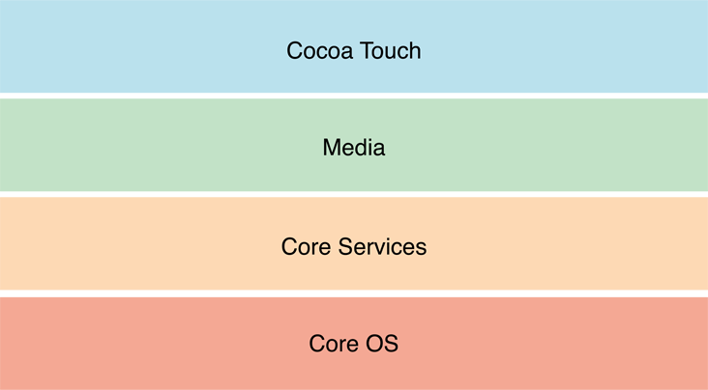
Layers of iOS
At the highest level, iOS acts as an intermediary between the underlying hardware and the apps you create. Apps do not talk to the underlying hardware directly. Instead, they communicate with the hardware through a set of well-defined system interfaces.

Slide 6
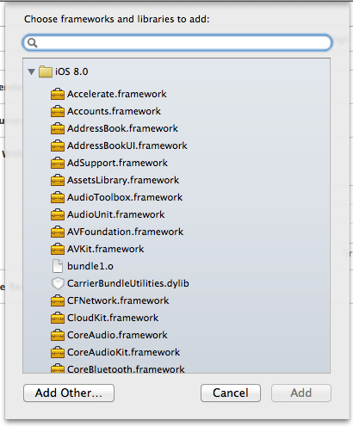
Frameworks
Apple delivers most of its system interfaces in special packages called frameworks.
A framework is a directory that contains a dynamic shared library and the resources (such as header files, images, and helper apps) needed to support that library.
To use frameworks, you add them to your app project from Xcode.

Slide 7
Developer library
The iOS Developer Library is an important resource for you to use during development. The library contains API reference, programming guides, release notes, tech notes, sample code, and many other resources offering tips and guidance about the best way to create your apps.
In Xcode, choose Help > Documentation and API Reference to display the Xcode documentation window

Slide 8
Cocoa touch
Address book UI framework
EventKit UI framework
GameKit framework
iAd framework
Mapkit framework
Message UI framework
Notification center framework
PushKit framework – registration for Voip
Twitter framework
UIKit framework ***

Slide 9
Cocoa touch high-level features
App extensions
  For example: share / widget
Handoff
  Handoff enables users to begin an activity on one device, then switch to another device and resume the same activity on the other device
Document Picker
  The document picker view controller (UIDocumentPickerViewController) grants users access to files outside your application’s sandbox
AirDrop
  AirDrop lets users share photos, documents, URLs, and other kinds of data with nearby devices.

Slide 10
Cocoa touch high-level features
TextKit
  TextKit is a full-featured, high-level set of classes for handling text and fine typography.
UIKit Dynamics
  http://www.teehanlax.com/blog/introduction-to-uikit-dynamics/
Multitasking
Auto Layout
Storyboards
  Storyboards are the recommended way to design your app’s user interface. Storyboards let you design your entire user interface in one place so that you can see all of your views and view controllers and understand how they work together

Slide 11
Cocoa touch high-level features
UI State Preservation
  When an app moves from the foreground to the background, it can preserve the state of its views and view controllers.
Apple Push Notification Service
Local Notifications
Gesture Recognizers
  Gesture recognizers detect common types of gestures, such as swipes and pinches in your app’s views.
Standard System View Controllers
  Such as image picker or calendar events

Slide 12
Media
The Media layer contains the graphics, audio, and video technologies you use to implement multimedia experiences in your apps. The technologies in this layer make it easy for you to build apps that look and sound great.
Graphics technologies
Audio technologies
Video technologies
Airplay
Media layer frameworks

Slide 13
Core Services
The Core Services layer contains fundamental system services for apps. Key among these services are the Core Foundation and Foundation frameworks, which define the basic types that all apps use. This layer also contains individual technologies to support features such as location, iCloud, social media, and networking.

Slide 14
Core OS
The Core OS layer contains the low-level features that most other technologies are built upon. Even if you do not use these technologies directly in your apps, they are most likely being used by other frameworks. And in situations where you need to explicitly deal with security or communicating with an external hardware accessory, you do so using the frameworks in this layer.

Slide 15
[MVC design pattern]

Slide 16
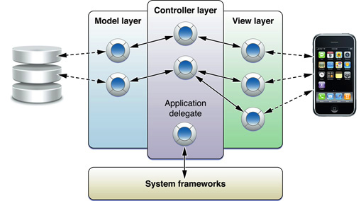
MVC
Model view controller design pattern

Slide 17
MVC
See PDF

Slide 18


Slide 19
[Xcode]

Slide 20
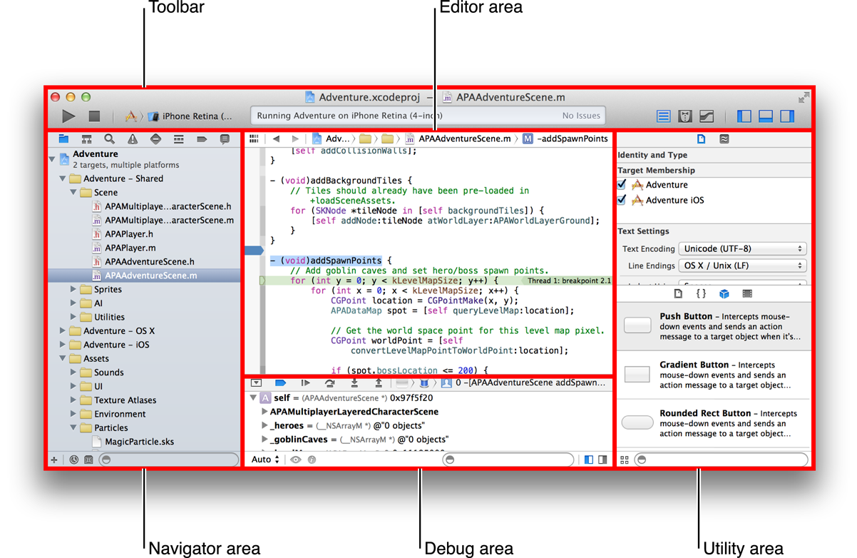
Overview

Slide 21
Tutorial: Basics “Hello world!”
https://developer.apple.com/library/ios/referencelibrary/GettingStarted/RoadMapiOS/FirstTutorial.html#//apple_ref/doc/uid/TP40011343-CH3-SW1

Slide 22
Homework
Apple developer account
Try it yourself – Hello World!
Review sample projects
  https://developer.apple.com/library/ios/samplecode/LookInside/Introduction/Intro.html#//apple_ref/doc/uid/TP40014643
  https://developer.apple.com/library/ios/samplecode/UICatalog/Introduction/Intro.html#//apple_ref/doc/uid/DTS40007710

Slide 23
Reading list
https://developer.apple.com/library/ios/documentation/miscellaneous/conceptual/iphoneostechoverview/iOSTechOverview.pdf

Slide 24
~ END ~
http://www.alphacamp.tw

